Slide 1

Care Centric Scheduling Calculator

Slide 2
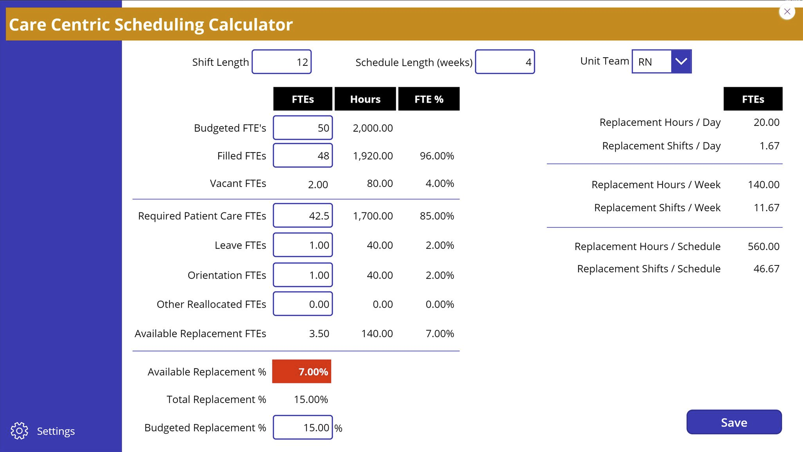
Care Centric Scheduling Calculator (CCSC) Robert Wingo, BSN, RN-BC CEO, Perceptive Staffing Innovations
Care Centric Scheduling Calculator
Notes:
Hello, my name is Robert Wingo, and I’m here to introduce you to the Care Centric Scheduling Calculator
I’m a board-certified informatics nurse that has 22 years’ experience in developing innovative solutions in and around nursing budgets and staffing and scheduling operations.

Slide 3

Problem Statement
Care Centric Scheduling Calculator
According to a 2021 analysis by Premier Inc., staffing shortages have cost hospitals $24 Billion during the pandemic.¹
Nurses are leaving the profession in record numbers due to staffing shortages, unsafe patient assignments, and mandatory overtime that leads to burnout, stress, and patient safety issues.
66% of nurses say that the pandemic has made them consider leaving the profession.²
“Nurses left the profession. They said, ‘this is not what I signed up for… You feel like you're in a war zone, quite frankly. If you don't have the right equipment, you don't have enough staff members around you. Yeah, it is quite overwhelming.”³
The Care Centric Scheduling Calculator (CCSC) provides a solution to creating safe and cost-effective schedules.
1 American Hospital Association. (November, 2021). Data Brief: Health Care Workforce Challenges Threaten Hospitals' Ability to Care for Patients. [Fact Sheet].
https://www.aha.org/fact-sheets/2021-11-01-data-brief-health-care-workforce-challenges-threaten-hospitals-ability-care
2 Becker's Hospital Review. (September 20, 2021). "66% of nurses say pandemic has made them consider leaving profession ”https://www.beckershospitalreview.com/workforce/66-of-nurses-say-pandemic-has-made-them-consider-leaving-profession.html
3 KING 5 News. (May 10, 2021). ‘You feel like you’re in a war zone’: Nurse shortage worse than ever due to COVID-19 pandemic, https://www.king5.com/article/news/health/nurse-shortage-covid-pandemic/281-79036c12-85ee-483e-a3c4-d9b14708ad38
Notes:
According to a 2021 study, staffing shortages have cost hospitals $24 Billion during the pandemic.
Nurses are leaving the profession in record numbers due to staffing shortages, unsafe patient assignments, and mandatory overtime that lead to burnout, stress, and patient safety issues. This trend is expected to continue until something is done to improve staffing conditions.
News articles have described working in the shortage as “overwhelming” and “like working in a war zone”.
One survey reports that 66% of nurses say that the pandemic has made them consider leaving the profession.
The Care Centric Scheduling Calculator provides a solution to creating safe and cost-effective schedules.​

Slide 4

Care Centric Scheduling Calculator Solution
Care Centric Scheduling Calculator
A B2B solution that effectively augments existing scheduling tools and will help healthcare organizations overspending on staffing solutions by:
Decreasing understaffing
Saving money
Increasing revenue
Improving work life balance of staff
Target Customers: Hospitals, Clinics, Long Term Care Facilities
Notes:
The CCSC is a B2B solution that effectively augments existing scheduling tools and will help healthcare organizations that are overspending on staffing solutions by:
Decreasing Understaffing
Saving money
Increasing revenue
Improving work life balance of staff
Our target customers are Hospitals, Clinics, Long Term Care Facilities

Slide 5
Care Centric Scheduling Calculator
Notes:
Here, is a screenshot of our working proof of concept for the Care Centric Scheduling Calculator that was designed in Microsoft PowerApps.
The app provides a common platform for reviewing FTEs , which is preferred by finance, alongside the hours and shifts preferred by nursing in order to facilitate discussions regarding resource needs and utilization.

Slide 6



Current Available Solutions
Care Centric Scheduling Calculator
The CCSC augments existing staffing and scheduling tools to provide a better understanding of how resource allocation affects staffing capacity.
The CCSC helps facilities to decrease understaffing, overtime costs, and employee burnout.
The CCSC also helps to identify facilities using a known flawed nursing FTE budget process that increases their risk of understaffing.
The problem is that currently available nurse staffing and scheduling systems do not provide the information that the CCSC does.
Notes:
The CCSC augments existing staffing and scheduling tools to provide a better understanding of how resource allocation affects staffing capacity.​
In doing so, it helps facilities to decrease understaffing, overtime costs, and employee burnout.​
It also helps to identify facilities using a known flawed nursing FTE budget process that increases their risk of understaffing.
The problem is that currently available nurse staffing and scheduling systems do not provide the information that the CCSC does.​

Slide 7

Implementation Costs
Care Centric Scheduling Calculator
Initial Startup Costs: $850,000
Legal Advice
Accounting
Marketing/Promotion/Advertising
Staff/Partners
Software & Licensing (Microsoft for Startups)
Webhosting
Notes:
To bring CCSC to market, we estimate our startup costs to be around $850,000 and these are the identified areas that need funding.

Slide 8

Scalability
Care Centric Scheduling Calculator
Start with Basic App on PCs and tablets
Expand with advanced app features
Dashboard / KPIs
Advanced data analysis
On-site and virtual training
On-site and virtual consulting, education, and change management support
Possible to expand market beyond healthcare
Notes:
We plan to start with a basic app on personal computers and tablets.
We have plans for future advanced functionality, training, education, consulting, and change management support.
And it’s possible to expand our market beyond healthcare.

Slide 9

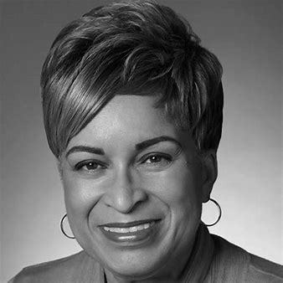


Care Centric Scheduling Calculator
CCSC Team
Robert Wingo
Marylyn Harris
Jane Krienke
Efe Igbide
Marylyn R. Harris, RN, MSN, MBA - Project Manager and Social Entrepreneur..
Robert Wingo, BSN, RN-BC
CEO, Perceptive Staffing Innovations
Efe Igbide, RN, MS, MSN Senior Healthcare Success Manager at Microsoft
Jane Krienke, Legislative Analyst at the Maryland Hospital Association
Notes:
Here we have the members of our amazing team.
Myself, Marylyn, Jane, and Efe

Slide 10
In Closing
Care Centric Scheduling Calculator
Mentoring
Funding
Technology Support
Marketing & Sales Support
Notes:
With your help, we can bring the Care Centric Scheduling Calculator to market.
We project that we will need assistance with:
Mentoring​
Funding​
Technology Support​
Marketing & Sales Support​

Slide 11
Thank you.
Care Centric Scheduling Calculator
Questions?
Notes:
Thank you for your time and consideration.
What questions do you have for our team?

